Slide 1


Slide 2
Risk Management
Risk
In the context of projects, risk is an uncertain event or condition that, if it occurs, has a positive or negative effect on project objectives

Slide 3
Risk management cont.
Risk management attempts to recognize and manage potential and unforeseen trouble spots that may occur when the project is implemented
Risk management identifies as many risk events as possible, minimizes their impacts, manages responses to those events that do materialize and provides contingency funds to cover risk events that actually materialize.

Slide 4
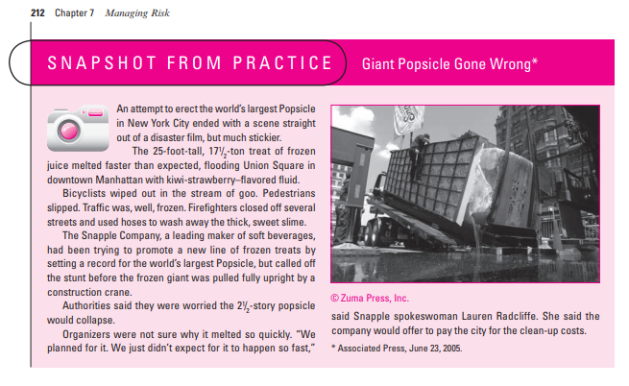

Slide 5
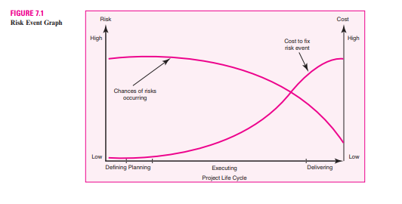

Slide 6
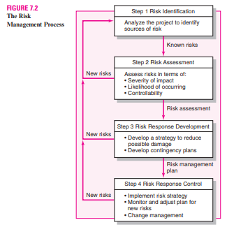

Slide 7
Risk Management Process
Step 1
Risk Identification
Step 2
Risk assessment
Step 3
Risk Response Development
step 4
Risk Response Control

Slide 8
Step 1 Risk Identification
The Risk management team uses brainstorming and other problem identifying techniques to identify potential problems
Participants are encouraged to keep an open mind and generate as many probable risks as possible.

Slide 9
One common mistake that is made early in the risk identification process is to focus on objectives and not on the events that could produce consequences.
For example, team members may identify failing to meet schedule as a major risk. What they need to focus on are the events that could cause this to happen (i.e., poor estimates, adverse weather, shipping delays, etc.).
Only by focusing on actual events can be found potential solutions

Slide 10
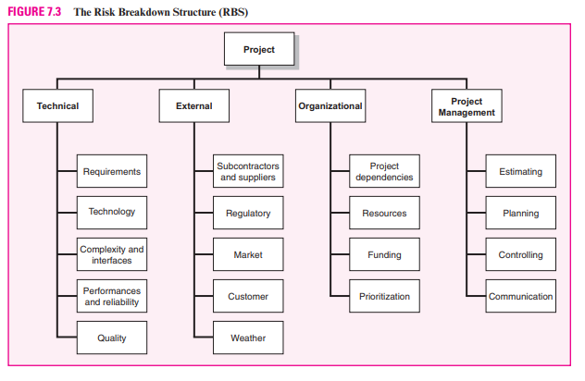

Slide 11
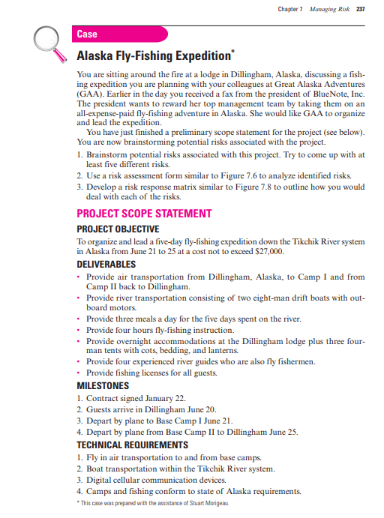

Slide 12
Step 2 Risk Assessment
Scenario analysis is the easiest and most commonly used technique for analyzing risks Team members assess the significance of each risk event in terms of Probability of the Impact of the event.
The quality and credibility of the risk analysis process requires that different levels of risk probabilities and impacts be defined. These definitions vary and should be tailored to the specific nature and needs of the project.

Slide 13
For example, A relatively simple scale ranging from “very unlikely” to “almost certainly” may
suffice for one project

Slide 14
Probality analysis:
Statistical variations of net present value (NPV) have been used to assess cash flow risks in projects. Correlations between past projects’ cash flow and S-curves (cumulative project cost curve—baseline— over the life of the project) have been used to assess cash flow risks.

Slide 15
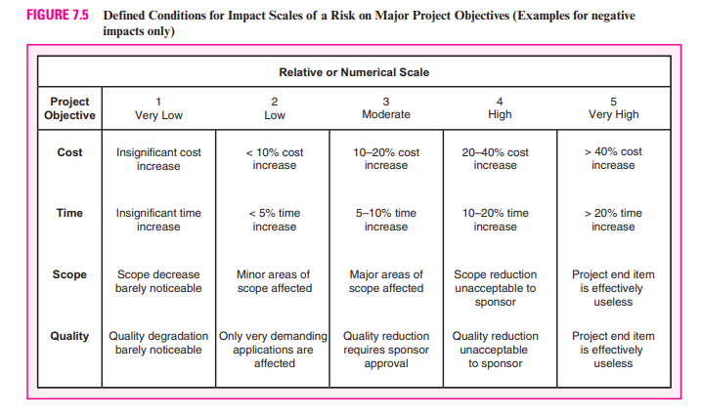

Slide 16
Step 3 Risk Response Development
When a risk event is identified and assessed, a decision must be made concerning
which response is appropriate for the specific event?
Responses to risk can be classified as mitigating, avoiding, transferring, sharing, or retaining.

Slide 17
Mitigating Risk
Reducing risk is usually the first alternative considered. There are basically two strategies for mitigating risk
(1) reduce the likelihood that the event will occur and/or
(2) reduce the impact that the adverse event would have on the project.
Most risk teams focus first on reducing the likelihood of risk events since, if successful, this may eliminate the need to consider the potentially costly second strategy

Slide 18
Avoiding Risk
Risk avoidance is changing the project plan to eliminate the risk or condition.
Although it is impossible to eliminate all risk events, some specific risks may be avoided before you launch the project. For example, adopting proven technology instead of experimental technology can eliminate technical failure.

Slide 19
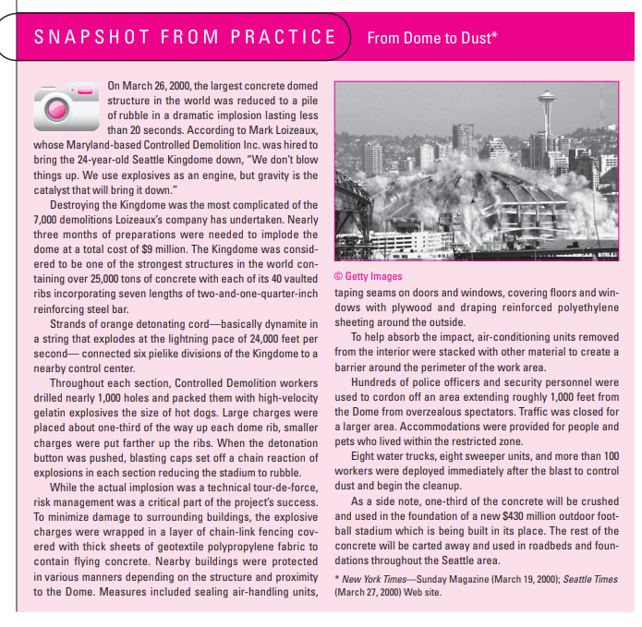

Slide 20
Transferring Risk
Passing risk to another party is common; this transfer does not change risk. Passing risk to another party almost always results in paying a premium for this exemption.
Fixed-price contracts are the classic example of transferring risk from an owner to a contractor. The contractor understands his or her firm will pay for any risk event that materializes; therefore, a monetary risk factor is added to the contract bid price. Before deciding to transfer risk, the owner should decide which party can best control activities that would lead to the risk occurring.

Slide 21
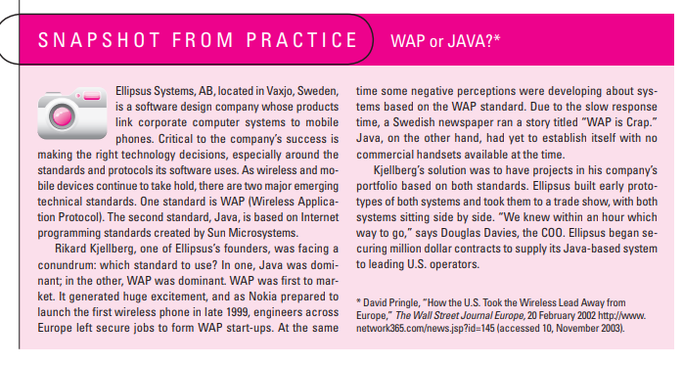

Slide 22
Retaining Risk
In some cases a conscious decision is made to accept the risk of an event occurring.
Some risks are so large it is not feasible to consider transferring or reducing the event
The risk is retained by developing a contingency plan to implement if the risk materializes. In a few cases a risk event can be ignored and a cost overrun accepted should the risk event occur.

Slide 23
Contingency plan
A contingency plan is an alternative plan that will be used if a possible foreseen risk event becomes a reality.
The contingency plan represents actions that will reduce or mitigate the negative impact of the risk event.

Slide 24
Like all plans, the contingency plan answers the questions of what, where, when, and how much action will take place. The absence of a contingency plan, when a risk event occurs, can cause a manager to delay or postpone the decision to implement a remedy
Contingency planning evaluates alternative remedies for possible foreseen events before the risk event occurs and selects the best plan among alternatives
This early contingency planning facilitates a smooth transition to the remedy or work-around plan. The availability of a contingency plan can significantly increase the chances for project success

Slide 25
most common methods for handling risk
Technical risk:
Technical risks are problematic; they can often be the kind that cause the project to be shut down.
In addition to backup strategies, project managers need to develop methods to quickly assess whether technical uncertainties can be resolved. The use of sophisticated CAD programs has greatly helped resolve design problems.

Slide 26


Slide 27
Opportunity Management
An opportunity is an event that can have a positive impact on project objectives.
Opportunities are identified, assessed in terms of likelihood and impact, responses are determined, and even contingency plans and funds can be established to take advantage of the opportunity if it occurs.
The project management profession has identified four different types of response to an opportunity:

Slide 28
Schedule Risks
Cost Risks
Funding Risks

Slide 29
1.Exploit
This tactic seeks to eliminate the uncertainty associated with an opportunity to ensure that it definitely happens.
2.Share
This strategy involves allocating some or all of the ownership of an opportunity to another party who is best able to capture the opportunity for the benefit of the project.

Slide 30
3.Enhance
Enhance is the opposite of mitigation in that action is taken to increase the probability and/or the positive impact of an opportunity.
4.Accept
Accepting an opportunity is being willing to take advantage of it if it occurs, but not taking action to pursue it.
While it is only natural to focus on negative risks, it is sound practice to engage in active opportunity management as well.

Slide 31
Contingency Funding and Time Buffers
Contingency funds are established to cover project risks—identified and unknown.
When, where, and how much money will be spent is not known until the risk event occurs. Project “owners” are often reluctant to set up project contingency funds that seem to imply the project plan might be a poor one.
The size and amount of contingency reserves depend on uncertainty inherent in the project. Uncertainty is reflected in the “newness” of the project, inaccurate time and cost estimates, technical unknowns, unstable scope, and problems not anticipated.

Slide 32
The contingency reserve fund is typically divided into budget and management reserve funds for control purposes. Budget reserves are set up to cover identified risks
Budget Reserves
These reserves are identified for specific work packages or segments of a project found in the baseline budget or work breakdown structure.
The reserve amount is determined by costing out the accepted contingency or recovery plan. The budget reserve should be communicated to the project team.

Slide 33
Management Reserve
These reserve funds are needed to cover major unforeseen risks and, hence, are applied to the total project.
Management reserves are established after budget reserves are identified and funds established. These reserves are independent of budget reserves and are controlled by the project manager and the“owner” of the project.

Slide 34
Time Buffers
Managers use time buffers to cushion against potential delays in the project.
Like contingency funds, the amount of time is dependent upon the inherent uncertainty of the project. The more uncertain the project the more time should be reserved for the schedule. The strategy is to assign extra time at critical moments in the project. For example, buffers are added to

Slide 35
A. activities with severe risks.
B. merge activities that are prone to delays due to one or more preceding activities being late.
C. noncritical activities to reduce the likelihood that they will create another critical path.
D. activities that require scarce resources to ensure that the resources are available when needed.

Slide 36
Step 4 Risk Response Control
Risk control involves executing the risk response strategy, monitoring triggering events, initiating contingency plans, and watching for new risks
The project team needs to be on constant alert for new, unforeseen risks
Management needs to be sensitive that others may not be forthright in acknowledging new risks and problems

Slide 37
Project managers need to establish an environment in which participants feel comfortable raising concerns and admitting mistakes.
The norm should be that mistakes are acceptable, hiding mistakes is intolerable.
Problems should be embraced not denied
Participants should be encouraged to identify problems and new risks. Here a positive attitude by the project manager toward risks is a key.

Slide 38
Change Management System
Change management systems involve reporting, controlling, and recording changes to the project baseline
In practice most change management systems are designed to accomplish the following:
1. Identify proposed changes.
2. List expected effects of proposed change(s) on schedule and budget.
3. Review, evaluate, and approve or disapprove changes formally.
4. Negotiate and resolve conflicts of change, conditions, and cost.

Slide 39
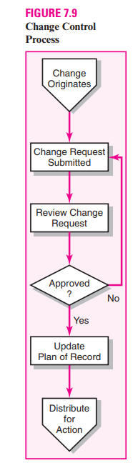
5. Communicate changes to parties affected.
6. Assign responsibility for implementing change.
7. Adjust master schedule and budget.
8. Track all changes that are to be implemented.

Slide 40
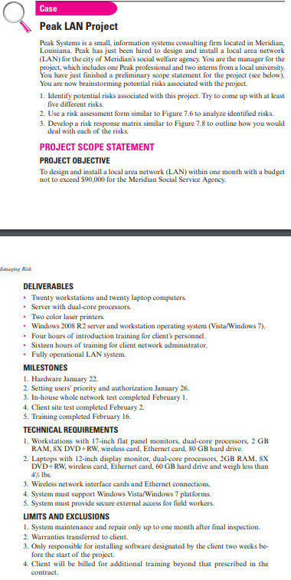

Slide 41
Tank You !

Slide 42
